Slide 1
ZS CAMPUS BEATS CHALLENGE
Krypto Motors
E-VEHICLE CASE STUDY

Slide 2
TEAM VALKYRIES
Pranika Kakkar
Aayushi Mer
Rishika Chaudhary

Slide 3
SECTION-1

Slide 4
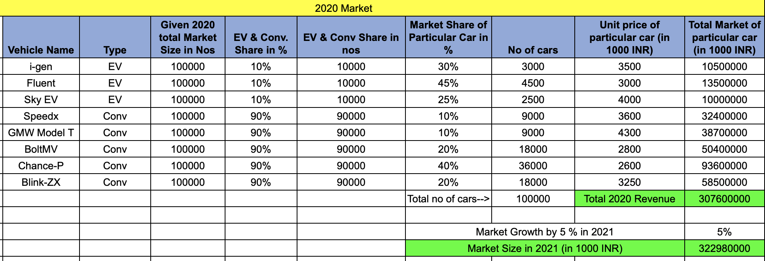
Q1 MARKET OPPORTUNITY
1.1 What will be the 2021 Market size in INR?
Table 1.1 Calculation of the Market Size in INR

Slide 5
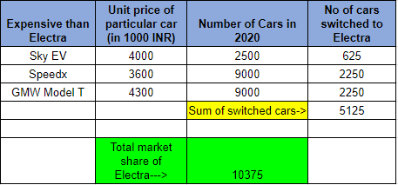
Q1 MARKET OPPORTUNITY
1.2 What would be 2021 Market share for Electra (based on units) if the car cost INR 3,500,000?
Assumption - Market growth is 5% i.e both electric and conventional cars are growing by 5%
Total cars in 2020 : 1,00,000
Total electric car share in 2020 : 10,000
Acc to assumption 5% growth in
Electric vehicles in 2021 :500
Half of electric vehicle growth goes
to Electra :250
5% of total cars in 2020 :5000
(definitely switch)
Table 1.2 Market Share of Electra
We are taking Sky EV, GMW Model T and Speedx because according to the survey 25% will switch if car is cheaper than existing car. And 5% will definitely switch to the new car.
Total Market Share of Electra (in units) = 250+ 25%(Cars expensive than Electra) + 5000
= 10,375

Slide 6
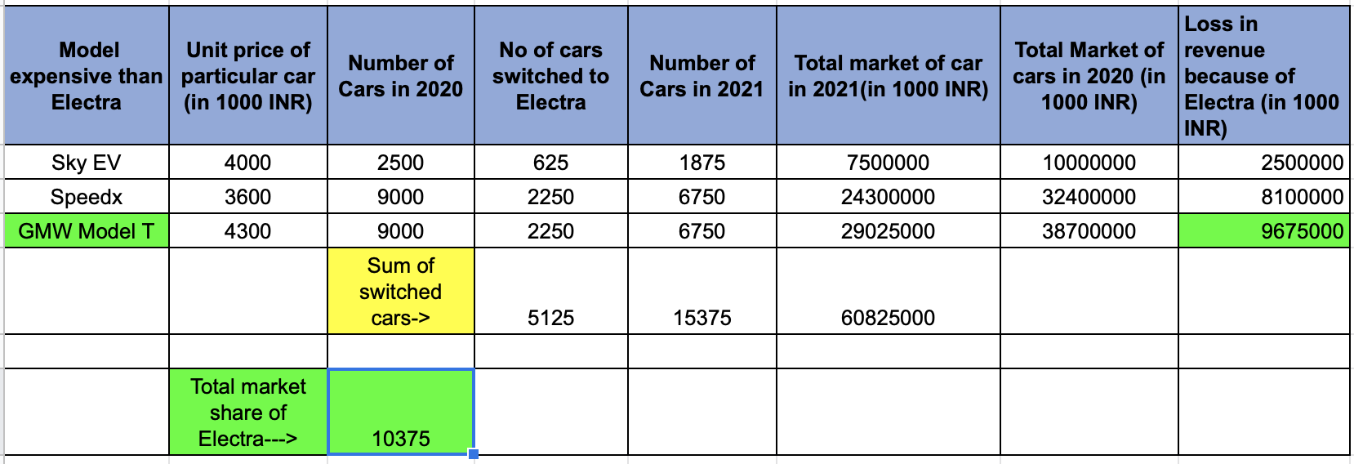
1.3 (a) Which car model will lose most revenue to Electra?
(b) What is the revenue lost by this car model to Electra?
Q1 MARKET OPPORTUNITY
Table 1.3 Loss in Revenue due to Electra

Slide 7
Q1 MARKET OPPORTUNITY
Assumption:
1. Price of cars in 2021 is same as price of cars in 2020.
2. According to the survey conducted 25% will switch if the car introduced is cheaper than the earlier cars and 5% will definitely switch but as we can see that 25% is comparatively greater than 5% so we will consider only the 3 cars which are expensive than Electra.
(a) According to the calculation made we can see that GMW Model T will lose the most revenue to Electra.
(b)The revenue lost by GMW Model T is 97,65,000 INR due to Electra.

Slide 8

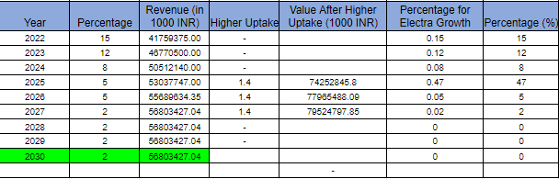
Q2. Forecast of Revenue
The revenue of Electra for 2021 will be 36312500 (in 1000 INR)
Table 1.4 Electra’s YoY Growth Calculation

Slide 9
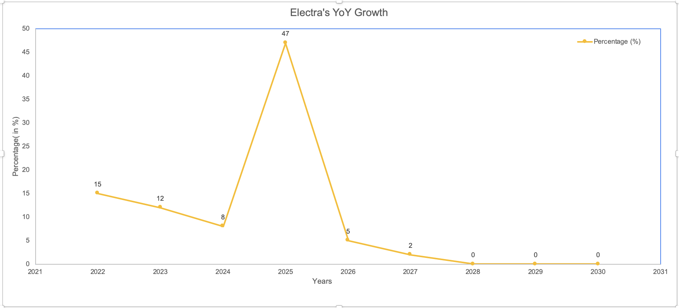
Q2. Forecast of Revenue
Graph obtained using the data of Table 1.4

Slide 10
Q3.1 a &Q3.1 b Marketing Mix Strategy
5 channels | % Annual Adv Budget | Budget Spent (in millions) | Expected Return (in millions)
Event | 40 | 4 | 80
Print | 30 | 3 | 20
Social Media | 10 | 1 | 20
T.V. | 10 | 1 | 15
Online | 10 | 1 | 8
The splitting of each channel is obtained by taking permutation and combinations of the above values, and the maximum expected return obtained was 143 million , for the above data.

Slide 11
Q3.2 Marketing Mix Strategy
Segment Name | Max Duration Spent | Channel (most watched)
Young Corporates | Social Network | Social Media
C-suite Corporates | Social Network | Social Media
Early Adopters | T.V. , Print, Social Network | T.V. , Print, Social Media
Private Business Owners | T.V. | T.V.
Commercial Use (Rental) | Print | Print
Tailoring our data on the basis of the engagement shown by different segments so that all the segments view the advertisement on the platform they relate to the most which is more likely to generate higher revenue.

Slide 12
SECTION-2

Slide 13
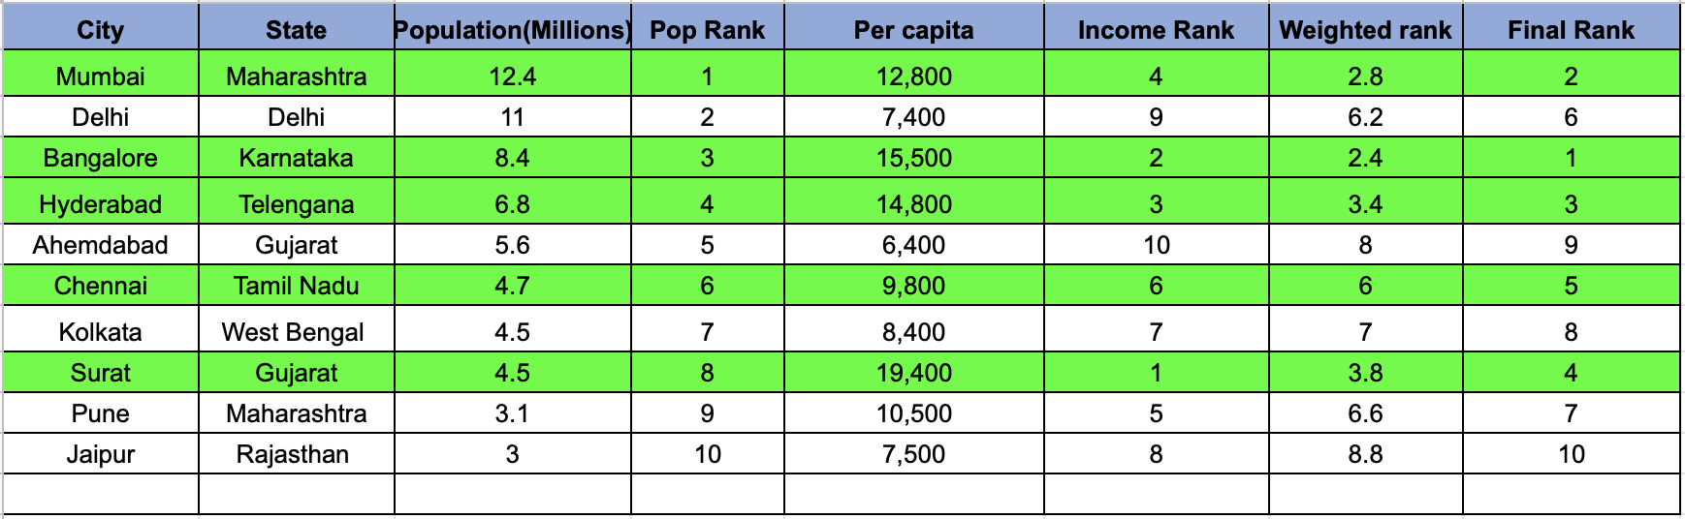
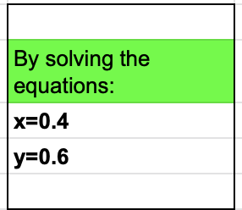
Q4.A IDENTIFY KEY CITIES FOR LAUNCH
Table 2.1 Key cities for Launch

Slide 14
Q4.A OUR APPROACH
Forming two linear equations in two variables and solving in them.
Solving
Linear equations
Let x be the weight given to the population and let y be the weight given to the per capita.
We have been given three weighted ranks so we use them to form equations.
Equation
Formation
Rank
Missing rank in income was filled according to the data.
x , y

Slide 15
Q4.A SOLUTION
y
Cities
x
Bangalore
Mumbai
Hyderabad
Surat
Chennai
0.4
0.6

Slide 16
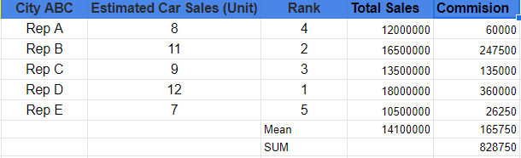
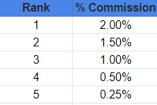
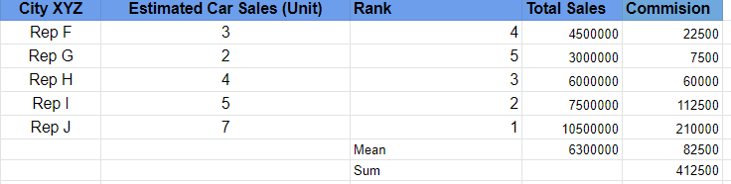
Q4.2A:IDENTIFY THE INCENTIVE BUDGET
Table 2.3 Q1’2021 Car sales estimation for City ABC
Table 2.2 Payout curve
Table 2.4 Q1’2021 Car sales estimation for City XYZ

Slide 17

SOLUTION
The expected incentive payout of City ABC and City XYZ Q1’2021 :
Fig 2.1 Car sales estimation for City ABC & XYZ
The above solution is calculated by taking the summation of the COMMISSION column , which is in accordance to the definition of INCENTIVE PAYOUT .
A monetary gift provided to an employee based on performance, which is thought of as one way to entice the employee to continue delivering positive results. Incentive pay may come in the form of a bonus, profit-sharing, or commission.

Slide 18

Q4.2B:IDENTIFY INCENTIVE BUDGET
Fig 2.2 Incentive Budget Calculation
The above calculation is done by :
Calculating the average of the two stores in the cities ABC AND XYZ ,
[(Total commission of city ABC+ Total commission of city XYZ)/2] .
Then multiplying the average of 1 store (calculated above ) and then multiply it by 5, as Krypto wants to launch 5 stores , which therefore gives us the total incentive budget.

Slide 19
Q5 IS THIS THE RIGHT STRATEGY
5.1 What could be other important parameters in selecting the cities for launching the experience stores? How will you accommodate these parameters in selection process – how important these parameters will be compared to each other?
The other parameters in selecting the cities for launching the experience store are-
One of the most essential parameter which has not been taken in account here ,is the level of COMPETITION , which the company might face. For instance ;if a location already has a number of stores which sell the same product and that of the same quality as our product ,then our profit outcome would not be as much when compared to a location which does not have stores selling this product.
Population has been considered as a parameter here ,however in accordance to our product, the percentage of LITERATE POPULATION is a more important parameter. As this product is eco-friendly , and helps in reducing pollution to a significant level, only the people who are AWARE of the consequences of using a conventional car ( increased level of pollution) would prefer to switch to an electric car.
CHARGING STATION are also a necessity for e-vehicles so that has to be taken into consideration about how many stations are there in the city. Along with this the ELECTRICITY RATE also needs to be taken into account because if its too expensive then people won’t buy the car.

Slide 20
Q5 IS THIS THE RIGHT STRATEGY
5.2 What are the drawbacks of the current compensation plan?
The drawback of the current compensation plan is that it is not uniform and not comprehensive of all the parameters. The selling of the car in the store will depend on the amount of people that who turn up to buy the car in that particular showroom. For example there are two areas P & Q where the stores have been located they do not have the population with same per capita income.
Let’s say that P has a population whose per capita income is greater in comparison to the population around Q . Due to this sales representatives in P showroom will be more likely to sell the car as the people coming to their store will have the money to buy them.
Also there can be a possibility that people in the area located our not aware of the need for the electric vehicles.
Hence, the sales representative in store P will have an advantage to get higher compensation over the sales representatives in store Q. Thus , based on sales number we cannot assign ranks to them.

Slide 21
Q5 IS THIS THE RIGHT STRATEGY
5.3 What are the other way you can suggest for calculating the payouts to avoid these drawbacks?
The others way we can use for calculating the payouts to avoid these drawbacks are
We can create some metric for the actual demand of the vehicle in the area where the store is located and if we find that the demand for the product is different in all the areas where the stores are located we can rectify this bias generated in sales with the help of some kind of normalization . We can assign a lower weight to the store while calculating payout with higher demand of product and a higher weight to the store with population having less demand.
We can look at the growth of the sales representative in the same store in a quarterly or annual period of time. The company would always want their employees to enhance their skills and outshine their own performance .

Slide 22
SECTION-3

Slide 23
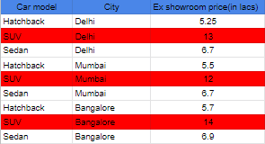
Q6 Recommend car for middle income group segment
Q6.1 Car with maximum seating capacity assuming customer has budget of 8 lakhs and can pay 4 lakhs as down payment and rest of the price/expenses in maximum of 3 years from day of purchase.
This table contains the Ex-showroom prices for the 3 models of the car available for buying. Here, the price of SUV, exceeds the budget of 8 lacs in all the three cities and therefore the customer cannot afford to buy an SUV.
Table 3.1 Ex-Showroom Prices

Slide 24

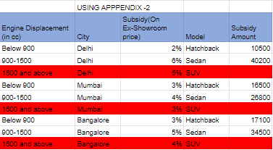
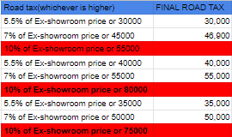
The rows coloured in red are not needed because they correspond to the the model SUV, which cannot be afforded by our customer . For our calculations ,we take in account the values which correspond to Sedan and Hatchback.
Table 3.2 Insurance Table
Table 3.3 Subsidy Amount (INR)
Table 3.4 Road Tax (INR)

Slide 25
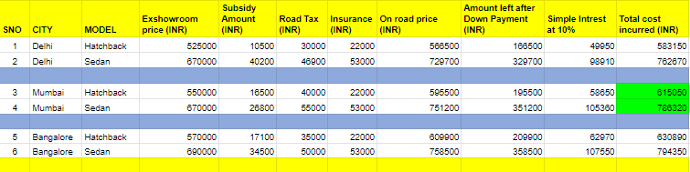
SOLUTION
Table 3.5 Final Cost Incurred Table
*Overall effective Interest taken as 10% for calculation of Total Cost Incurred
According to the calculations done by the given data, the recommended car for the person in Mumbai is Sedan because it suits the conditions of the person. Sedan has the maximum capacity of 7 seats among other available options and it is under 8 Lakhs as the total cost incurred is 7,86,320 INR including the down payment of 4 lacs. After the down payment the rest of the amount can be paid in installments with 10% interest within maximum of 3 years. With this scenario the person can pay the rest of the amount under 1 year with 10% interest.

Slide 26



Q6.2 Calculation of money spent after paying the down payment of the car in 4 years if we travel 11560 km per year on average.
Table 3.6 Electricity price per KWhr
Table 3.7 Maintenance cost per year
Operational Cost = Total maintenance cost + Electricity Cost per KM * Total distance travelled
Table 3.8 Electricity price per km

Slide 27

SOLUTION
Operational Cost per year: 28,220 INR
For 4 years operational Cost: 1,12,880 INR
After Down Payment Amount Left: 3,86,320 INR
Total Payment: 4,99,200 INR
This is the total amount of money the person will spend after paying the down payment of the car in 4 years and if he/she travels 11560 kilometers per year on an average.
Table 3.9 Total money spent after the down payment of the car

Slide 28
Q7 Dashboard Creation
Q7) Refer to Appendix 2 and recommend some of the quality checks you would put in place. Also, highlight the errors if there are any.
We are going to look for the following quality checks in the given data table : -
All the order IDs should be unique.
All the Customer names should have unique customer ID should be unique.
All the postal code should be of 6 digits.
All the prices should be positive .
Finance amount should always be less than MRP.
The ship date should not be earlier than order date.
The postal codes should match with the cities
There should be no empty blanks in the data all the rows and columns should be filled in the table.
If the exchanged column is No, then the exchange discount should be 0 , if yes then it should not be 0.
If financed is No, then financer and financed amount should be NIL.
The states and cities should correspond to one another.
Discount can never be more than 100%.
The exchanged discount amount should be removed from the profit.

Slide 29
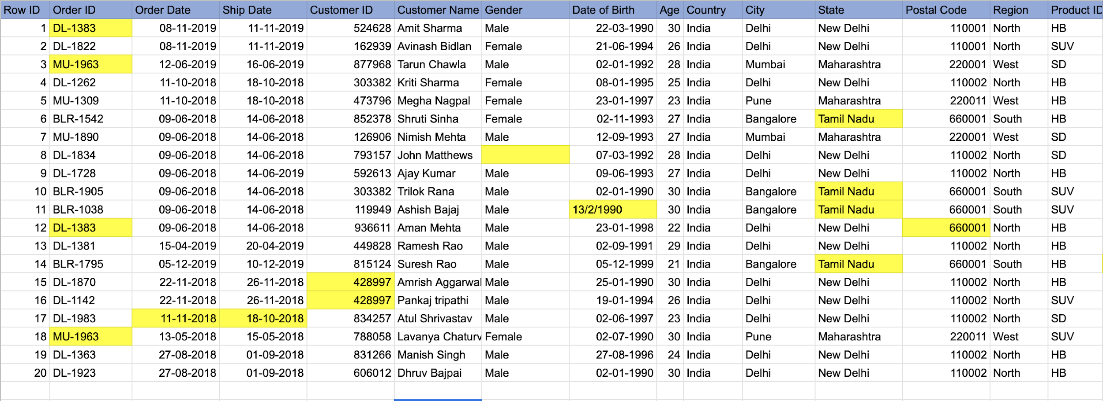
Table 3.1 The highlighted yellow data shows the error according to the quality checks suggested in the previous slides

Slide 30
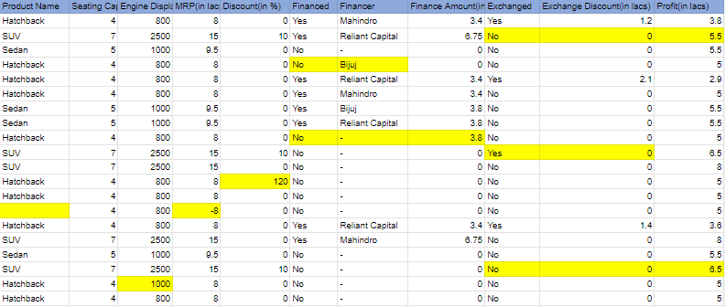
Table 3.1 Continuation of the other columns in the table

Slide 31

Q8 Appendix 2 contains sample records for Sales data of last 2 years of the automobile industry. Create a relational database of star schema from the data.
In the sheet given below, Orders_FACT we have -
OrderId as the primary key.
CustomerID ,RegionID, ProductId, FinanceID are the foreign keys.
OrderDate and ShipDate are the normal data columns.
Then the foreign keys have their own data columns.

Slide 32
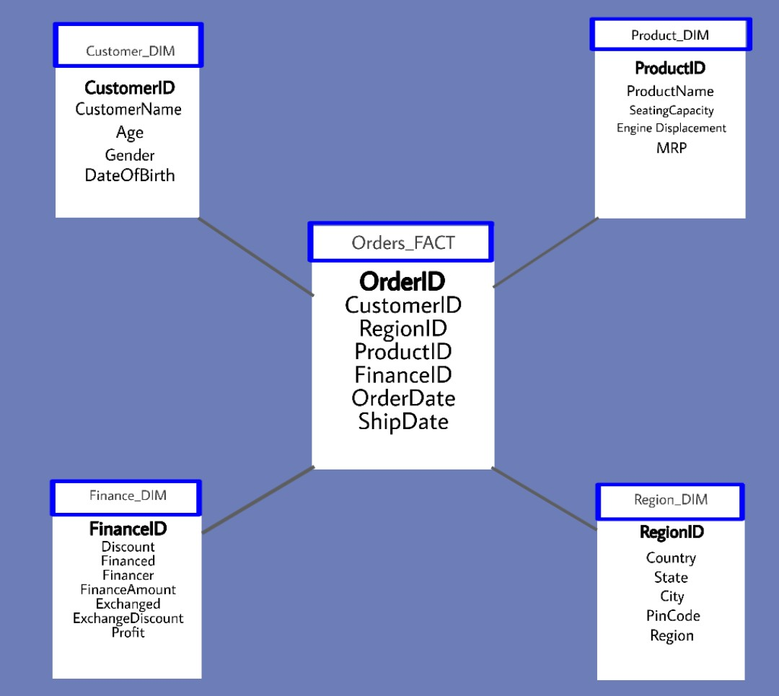
Star Schema

Slide 33
About the relational database of star schema
The relational database of star schema is useful in data warehousing solutions and centres. It's useful because it makes data retrieval(querying) easy. However managing it is difficult.
Now a particular order has a lot of related information. For example information like who has placed the order, where it was placed and so on. Since all this data has to be stored in different tables there is one master table(fact table) which connects all these different properties(dimension tables) together.
So the Order_FACT is the master table containing information related to the order and for other information it has ID's for the other tables which we can use to look up data. For example in our database - Customer Id in Order_FACT connects to Customer Id in Customer_DIM table. Customer_ID in Order_FACT is the foreign key to Customer Id in Customer_DIM primary key.

Slide 34
Q9. Creating a dashboard
This question requires us to create a dashboard from the sales data available in Appendix 2. As suggested in the previous slide , this data contains errors like empty spaces , same order ID’s , negative MRP, etc. Therefore , in order to create a dashboard we have had to make several ASSUMPTIONS , by filling up these empty spaces and correcting a few errors which might cause hindrance in making the graphs.

Slide 35
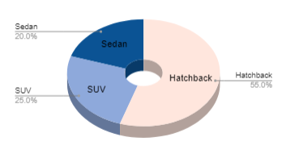
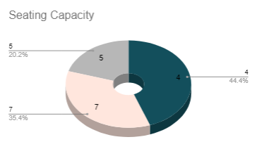
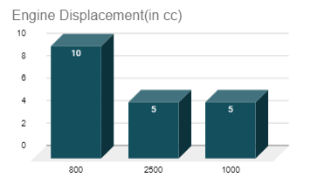
Car Specific Data
These graphs were plotted to see what all features are important to a customer when they want to buy a new car. People are more interested in Hatchbacks with 4 seating capacity and with an engine of 800 cc. When comparing Sedan to SUV people choose SUV as their preference.
Fig 1. Types of Car Model
Fig 2. Seating Capacity
Fig 3 Engine Displacement

Slide 36
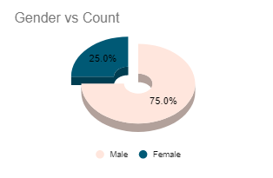
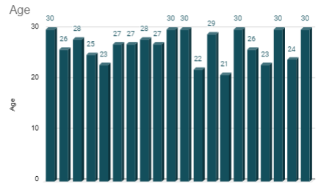
Customer Specific Data
These graphs were plotted to see which is the target audience which are most interested in buying a car. According to the data provided Males are more likely to buy a car with 75% accounting out of the total. When it comes to age then most of the buyers are in the range 22-30 with most of them lying the range 27-30 years.
Fig 4. Gender vs Count
Fig 5. Age Count

Slide 37
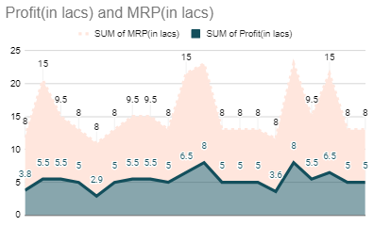
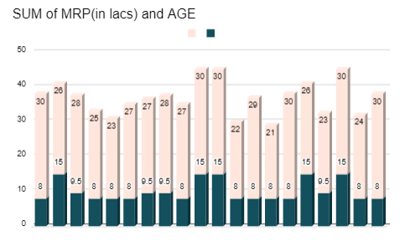
MRP related Specific Data
Fig8. Sum of profit (in lacs) and Sum of MRP(in lacs)
These graphs were plotted to give an idea about the profit that the company can make with the given MRP. These profits are taken into account after all the accounts are taken like exchanging cars. According to Fig9. MRP and Age graph older people are willing to but expensive cas.
Fig 9. Sum of MRP (in lacs) and AGE

Slide 38
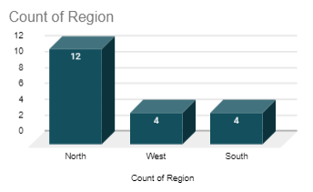
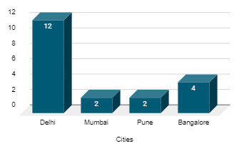
Region Specific Data
These graphs are plotted to give us an overall sense of visual contrast which makes it more digestible at a glance. For example; The information gathered from the graph here tells us that the maximum potential of buyers for these types of cars come from the Northern
Region of India, mainly Delhi. While ,the amount of people buying the product is approximately same in the Southern and Western region of India.
Fig 6. Regional Count
Fig 7.City Count of Cars

Slide 39
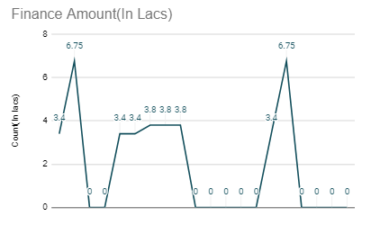
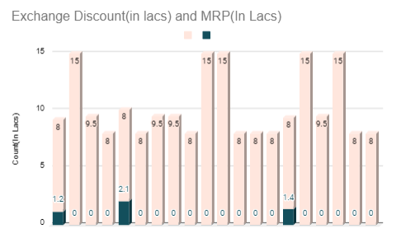
Additional Finance Data
These graphs were plotted to see how many customers need financial help via some finance aid and who all are willing to exchange their cars when buying a new car. But we can see that very less people are exchanging their cars.
Fig10. Finance amount in lacs
Fig11. Exchange Discount(in Lacs) & MRP(In Lacs)

Slide 40
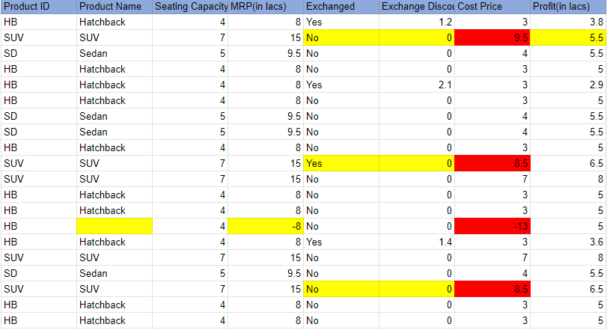

Q10 Cost Price of SUV, Sedan, Hatchback

Slide 41

SOLUTION
We know that the formula for Cost Price:
Cost Price = Selling Price- Profit
To calculate the cost price for the 3 models ,we have taken into account the data given in Appendix 2. The data had some ambiguities like the MRP for hatchback in one of the columns was marked as -8 which cannot be true. When we are calculating Cost Price then exchange amount should not be taken into account because cost price remains same throughout. So we subtracted exchange amount from profit amount and then calculated cost price.
There was some error in the exchange and profit data also as the profit was reduced even when there was no exchange which cannot be possible according to the given data. So those cost price are marked in red. A common cost price for hatchback was 3 Lacs, for sedan was 4 Lacs, and for SUV was 7 Lacs.
Fig11. Cost Price of Models

Slide 42
Excel Sheet for all the Answers

